Slide 1



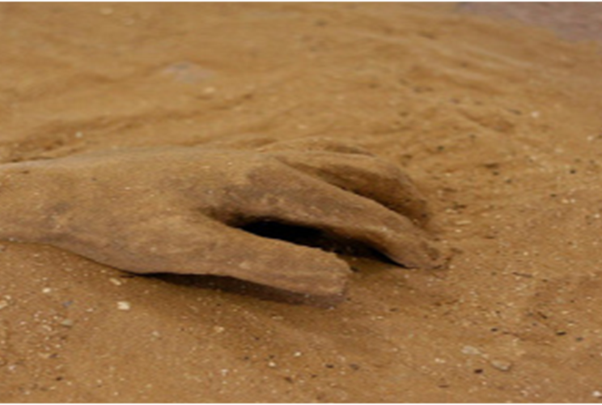
What is a good man?
Rev. Willie Glaster
November 8, 2025
A former Round Table Discussion on
June 20, 2019

Slide 2
Table of Contents
A Dilemma
Definitions
Male Privilege
How Do I Become A “Good” Man?
Biblical Perspectives about Pornography
I DO NOT OWN THE RIGHTS TO ANY IMAGES, VIDEOS OR MUSIC
THIS IS FOR TRAINING PURPOSES ONLY

Slide 3
A Dilemma
In April 2018, a 29-year-old suspect at a Home Depot, a hardware store, shot and wounded two Dallas Police Department Officers and a civilian security guard; one of the officers died the next day.
Suspect's family reactions
The father said that he couldn't believe his son was responsible for gunning down three people. "There's no way my son could've done this," he said, adding that he doesn't think his son owned a gun. However, he said police had gone to the mother's house to look for his son and showed the video of him shooting officers in the face.
The grandmother, said that when police came looking for her grandson, they told her he'd been caught stealing at a Home Depot and someone had been hurt.
"He's a very sweet, sweet, lovable person," she said. "He doesn't carry a gun. He doesn't have a gun. He’s a good Christian boy.”

Slide 4
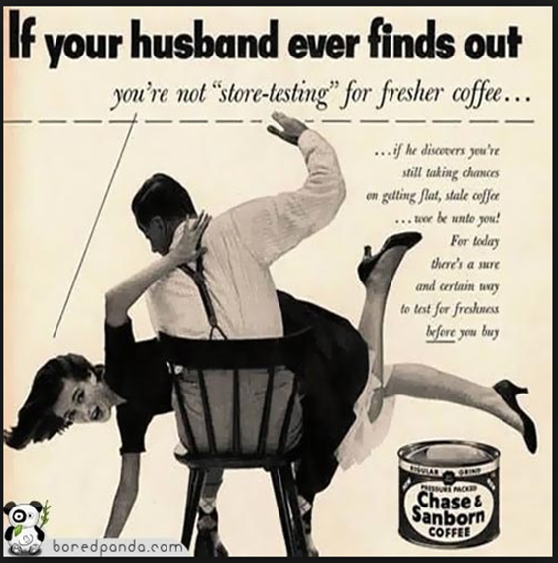
MISOGYNY
The hatred of, contempt for, or prejudice against women or girls. Misogyny manifests in numerous ways, including social exclusion, sex discrimination, hostility, androcentrism, patriarchy, male privilege, belittling of women, disenfranchisement of women, violence against women, and sexual objectification. Misogyny can be found within sacred texts of religions, mythologies, Western and Eastern philosophy.

Slide 5
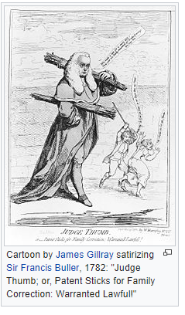
Rule of thumb - Misogyny
The English phrase rule of thumb refers to a principle with broad application that is not intended to be strictly accurate or reliable for every situation. It refers to an easily learned and easily applied procedure or standard, based on practical experience rather than theory. This usage of the phrase can be traced back to the seventeenth century, and has been associated with various trades where quantities were measured by comparison to the width or length of a thumb.
A modern folk etymology holds that the phrase derives from the maximum width of a stick allowed for wife-beating under English law; this belief may have originated in a rumored statement by the eighteenth-century judge Sir Francis Buller that a man may beat his wife with a stick no wider than his thumb. The rumor produced numerous jokes and satirical cartoons at Buller's expense.
The English jurist Sir William Blackstone wrote in his Commentaries on the Laws of England of an "old law" that once allowed "moderate" beatings by husbands, but did not mention thumbs or any specific implements. several nineteenth-century American court rulings referred to an "ancient doctrine" that the judges believed had allowed husbands to physically punish their wives using implements no thicker than their thumbs.
The exact phrase rule of thumb first became associated with domestic abuse in the 1970s, after which the spurious legal definition was cited as factual in a number of law journals, and the U.S. Commission on Civil Rights published a report on domestic abuse titled "Under the Rule of Thumb" in 1982.

Slide 6

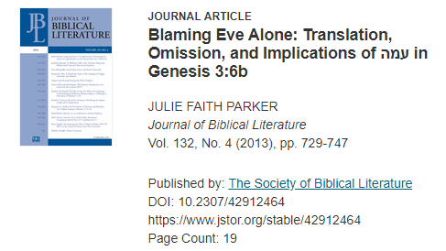
The Journal of Biblical Literature article by Judith F. Parker, Blaming Eve Alone brings considerable consequences not only for understanding Genesis 3:6, but also for generating ideas about women. Interpreters tend to blame only Eve for succumbing to temptation in the garden, even though Adam is present in Gen 3:1-6 and shares responsibility for disobedience.
Adam “was with her”, therefore, without excuse. He should have spoken up and protected his mate and his dominion.

Slide 7
Male Privilege

Slide 8
In the field of sociology, male privilege is seen as embedded in the structure of social institutions, as when men are often assigned authority over women in the workforce, and benefit from women's traditional caretaking role.[3] Privileges can be classified as either positive or negative, depending on how they affect the rest of society.[1]
Positive advantages include having such things as adequate nutrition, shelter, and health care, whereas negative advantages accompanying male privilege include such things as the expectation that a man will have a better chance of being hired for a job.
Overview

Slide 9
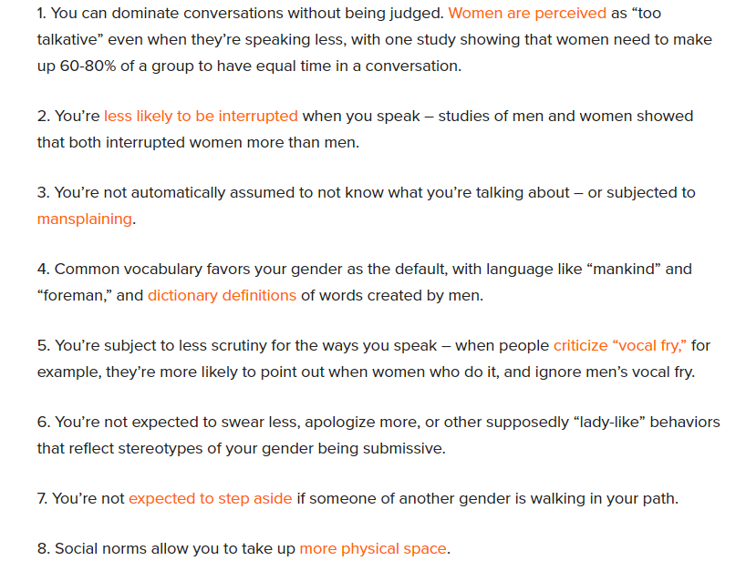
160+ Examples of Male Privilege in All Areas of Life
Social Norms

Slide 10
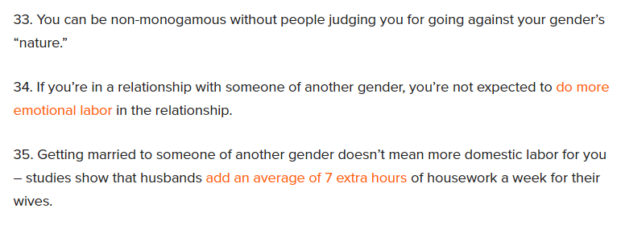


Slide 11
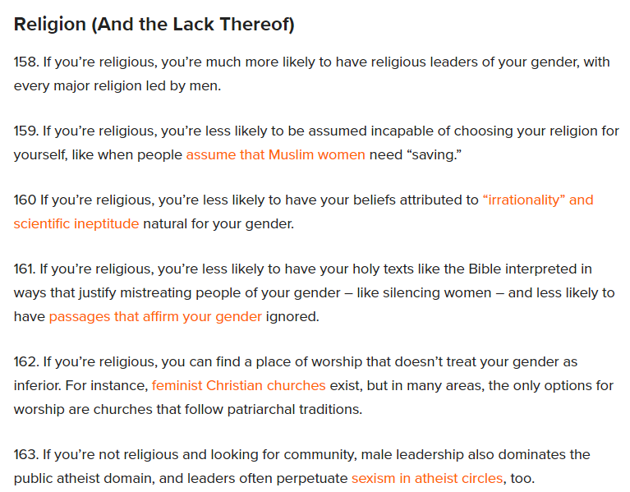
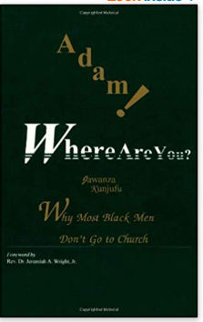

Slide 12
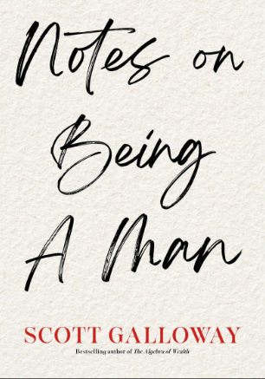
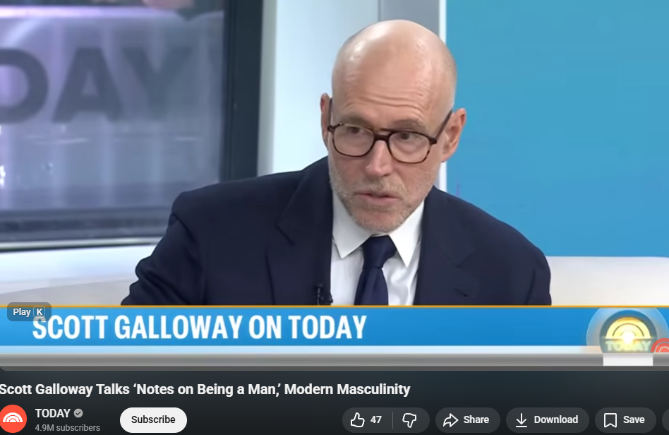
Scott Galloway is a Professor of Marketing at NYU’s Stern School of Business

Slide 13
Themes from the book Notes on Being a Man
Boys are not graduating from high school at an alarming rate. One in seven men reports having no friends, and men account for three of every four deaths of despair in America.
Even worse, the lack of attention to these problems has created a vacuum filled by voices espousing misogyny, the demonization of others, and a toxic vision of masculinity.
There is nothing more dangerous than a lonely, broke young man.

Slide 14
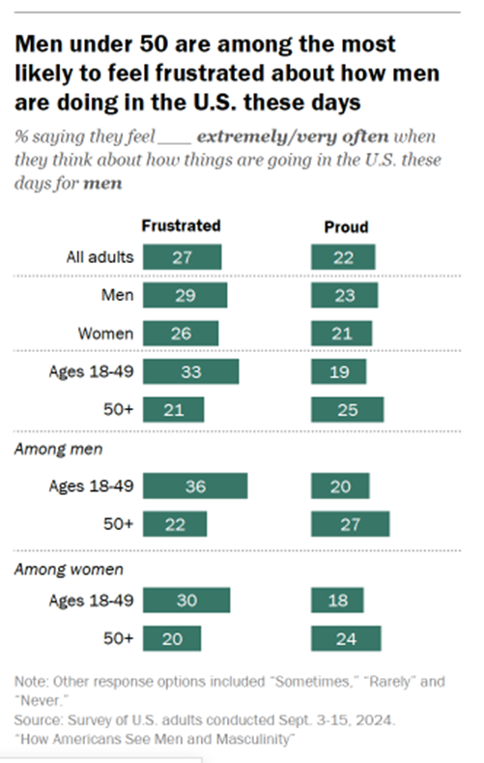
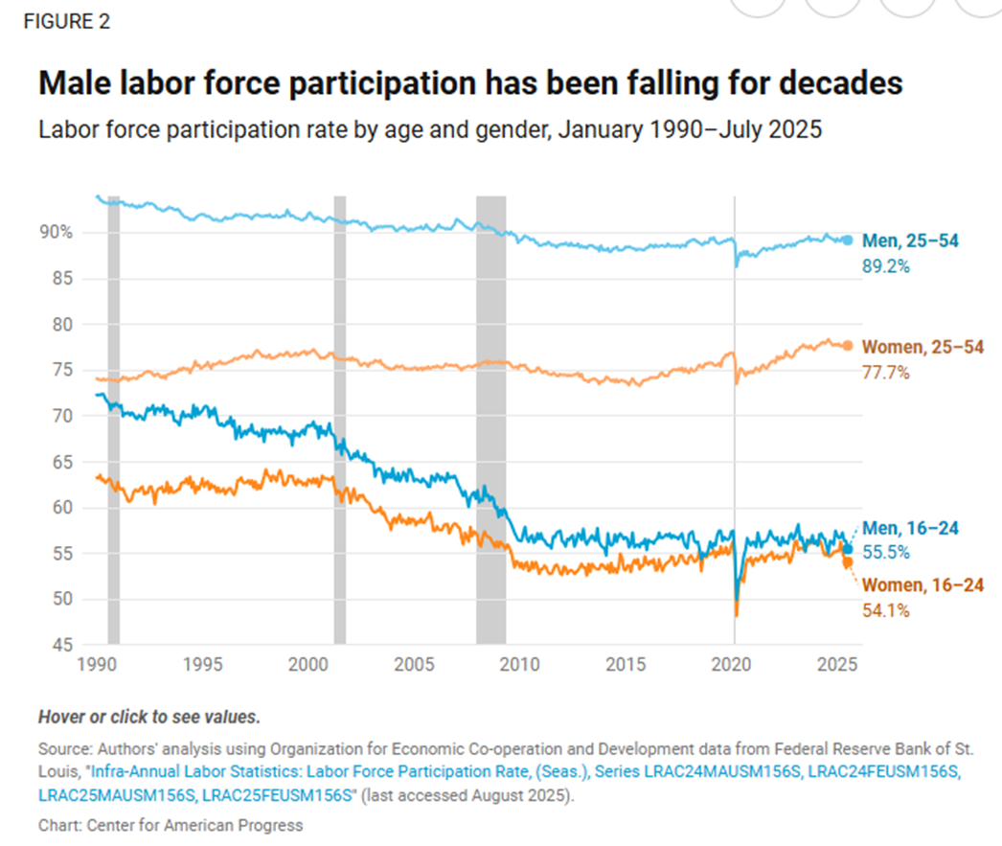

CENTER FOR AMERICAN PROGRESS

Slide 15
Biblical Perspectives on
How Do I Become A Good Man?

Slide 16
Biblical Perspectives on How Do I Become A Good Man?
Psalm 34: 11-14 Good News Bible A psalm of David
The passage begins by addressing the "children," stating that the author will teach them the fear of the Lord. It then poses a question to those who want a good and long life:
11: Come, my young friends, and listen to me, and I will teach you to honor the LORD.
12: Would you like to enjoy life? Do you want long life and happiness?.
13: Then keep your tongue from speaking evil and your lips from telling lies.
14: Turn away from evil and do good; strive for peace with all your heart

Slide 17
Biblical Perspectives on How Do I Become A Good Man?
Life is short, and you, love your wife, so enjoy being with her. This is what you’re supposed to do as you struggle through life on this earth. Ecclesiastes 9:9
A good man obtains favor of the Lord; but the man of wicked devices will he condemn. Proverbs 12:2
If you do what the LORD wants, he will make certain each step you take is sure. Psalm 37:23
Ask that the LORD perfect your life to bring Him glory. See Paul’s prayer in Colossians 1:3, 9 – 12. (Items #5 – 8 are related to this one)
Ask the LORD to bring into perfection your spiritual strength and endurance. See also Proverbs 16:3

Slide 18
Biblical Perspectives on How Do I Become A Good Man?
6. Give joyful thanks to the Father, who has qualified you to share in His inheritance.
7. Learn to hear what the Father would like to say to you.
8. Work out the kinks in your life and in your family through prayer.
9. Express your deepest feelings to the LORD and trusted friends. Remember there’s nothing new under the sun. See the Book of Ecclesiastes.

Slide 19
Biblical Perspectives on How Do I Become A Good Man?
10. Learn to walk with the LORD like Enoch did. See Genesis 5:21-24.
When Enoch was 65, he had a son, Methuselah. After that, Enoch lived in fellowship with God for 300 years and had other children. He lived to be 365 years old. He spent his life in fellowship with God, and then he disappeared, because God took him away.
To "walk with God" means to live in close, consistent fellowship with Him by aligning your thoughts, decisions, and actions with His will and teachings. It involves staying in step with God's path, being obedient, and making all life choices in light of God's revelation, rather than following one's own desires.
Hint, he was 65 years old when he started. In other words, you’re not too old to begin!

Slide 20
The Role of Man as Protector: Exploring Biblical Perspectives
In the Bible, men are often portrayed as protectors, warriors, and guardians of their families, communities, and nations. This theme of man as protector can be seen throughout various stories and passages in the Old and New Testaments, highlighting the important role that men play in providing safety, security, and leadership.
Ephesians 5:25-29 instructs husbands to love their wives as Christ loved the church, sacrificially and selflessly, providing both physical and emotional protection. This passage highlights the biblical mandate for men to serve as protectors and providers for their families, laying down their lives if necessary for the well-being of their loved ones.
Furthermore, men are called to be protectors of their families spiritually, emotionally, and physically. This includes providing a safe and loving environment for their loved ones, standing up for justice and righteousness, and being a source of strength and support in times of need.
Internet article on Bible Wisdom Hub by Denny Burk, Professor of Biblical Studies at Boyce College,
the undergraduate school of the Southern Baptist Theological Seminary in Louisville, KY

Slide 21
The Role of Man as Protector: Exploring Biblical Perspectives
Why should men be protectors?
In the context of the Bible, men should be protectors because it is a role that is often emphasized throughout the scriptures. In Ephesians 5:25-29, husbands are instructed to love their wives as Christ loved the church and gave Himself up for her. This sacrificial love involves protecting and caring for one’s spouse in a selfless and honorable manner.
Additionally, in 1 Timothy 5:8, men are urged to provide for their families, and providing includes protecting them from harm and danger. This can involve physical protection, emotional support, and spiritual guidance.
Ultimately, being a protector is a way for men to demonstrate their love and commitment to their loved ones, following the example set by Christ in His sacrifice for the church.

Slide 22
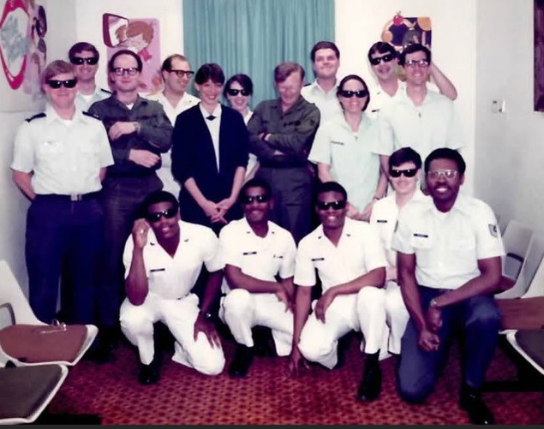

Slide 23
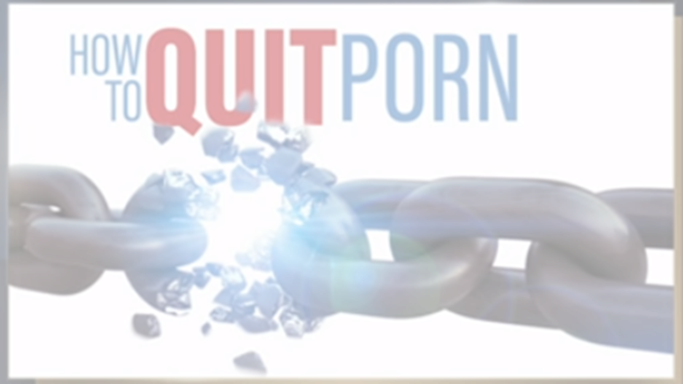
Beyond Today
https://youtu.be/Rp8b0_nc6IQ

Slide 24

The impact of pornography on relationships, individual health, and society is in the public eye more than ever before. Pornography use is widespread, and often problematic, and has been shown to generally have a negative impact on couples and gender relations, leading men and women to devalue one another. …. the rule is that pornography is dominated by hostile sexism, frequent violence, and general dehumanization and objectification. Because of how sex impacts the brain, pornography essentially short-circuits other systems, becoming not only addictive, but also undermining secure attachment, mutual relatedness, and intimacy.
4 Ways Porn Use Causes Problems
New research on sexual satisfaction, loneliness, and relationship stability.
- March 5, 2018

Slide 25
Biblical Perspectives on the effects of porn
As with any other sin, here are some of the effects on the man:
Flight from Reality
Denial
Self-Deceit (trying to fool others)
Insensitive
Self-Centered (Selfish)
Restlessness
Effect on Others
Competition
Unable to Empathize
Rejection of Authority
Inability to Love

Slide 26
1. Sexual Satisfaction
More frequent porn viewing was associated with lower sexual satisfaction…. They found that individual differences were associated with differences in the negative impact of porn use. For factors including male gender, being in a committed relationship, and being more religious, this research showed that sexual satisfaction began to decline with pornography use of a few times a year. Notably, under no circumstances was pornography use associated with greater sexual satisfaction. These findings suggest that even infrequent use of pornography has negative effects on sexual satisfaction.

Slide 27
2. POPULARITY
If porn is taken as a “how-to” manual for sex, it does a bad job, to say the least. When it comes to instructing viewers on sexual pleasure, porn is generally inaccurate and likely to lead to low-quality sex and as well as one-dimensional, likely unsatisfying sex for males.

Slide 28
3. Loneliness
Pornography use begets loneliness, and loneliness begets pornography use. In Pornography Use and Loneliness: A Bidirectional Recursive Model and Pilot Investigation, Butler, Pereyra, Drap, Leonhardt, and Skinner (2018) surveyed 1,247 participants in English-speaking countries around the world to develop a sophisticated statistical model of how various factors related to loneliness and pornography use. Overall, they found that porn use was significantly associated with loneliness.

Slide 29
4. Divorce
Researchers found that the association between pornography use and divorce was much higher for younger people. 50% of the 20-year-olds who began using pornography after marriage, got divorced (versus 6 percent who did not start using porn), 28% of 30-year-olds, and 12% of 40-year-olds.

Slide 30
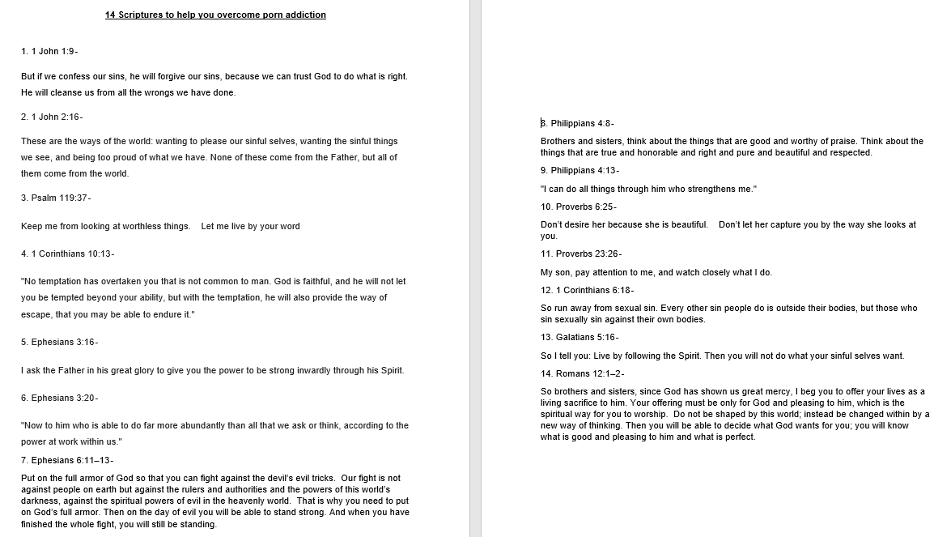
14 SCRIPTURE VERSES TO HELP YOU
***SEE THE HANDOUT***

Slide 31


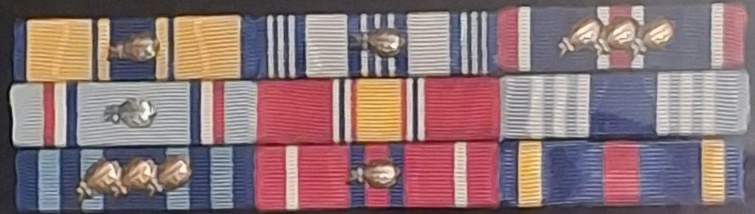
DECEMBER 1980 - DECEMBER 2000

Slide 32
THE END
ANY QUESTIONS?

